Slide 1
json23plet
final presentation
under supervision of: Dr. Oren Mishali
Tdk lab
presented by: Yogev Henig
Yehonatan Buchnik
Yaakov Sokolik

Slide 2
Overview
json23plet is a Linux command line tool, which was developed in the TDK lab as part of the JBS (Jewish Bookshelf) project.
The goal of the JBS project is to build a semantic web database of Jewish books.
The main purpose of json23plet is to provide a simple functionality to deal with any kind of data contained in Json files. json23plet creates RDF statements in Turtle format that help construct a semantic web domain.

Slide 3
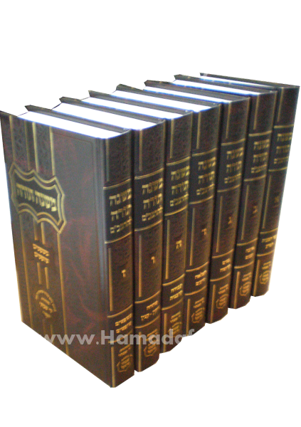
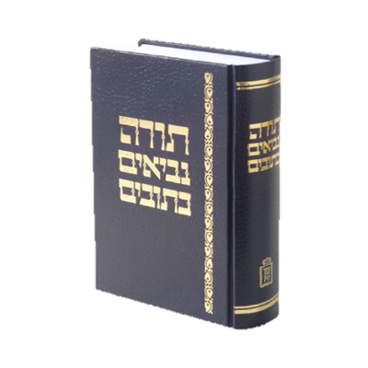

JBS workflow
jbs-tagger
jbs-text2json
Json files that contain data
jbs-json23plet
Semantic Web database of the Jewish Bookshelf !

Slide 4
Motivation
The Jewish book shelf contains a lot of data – many thousands of books.
Creating a Semantic web directly from it, is a very difficult mission because:
There is not a unified format for the text
Ontology may change
It is hard to identify relations
And more…

Slide 5
Motivation
On this task different teams worked parallel:
Text2json – create a Json files from a raw text
Taggers – identify relations inside the raw text and save it in Json files
Json23plet – create RDF model from all Json files.
This method of work achieved:
Parsing raw text only once.
Regenerate RDF triples from Json files easily due to their simple format.
Maintain and development become easy.

Slide 6
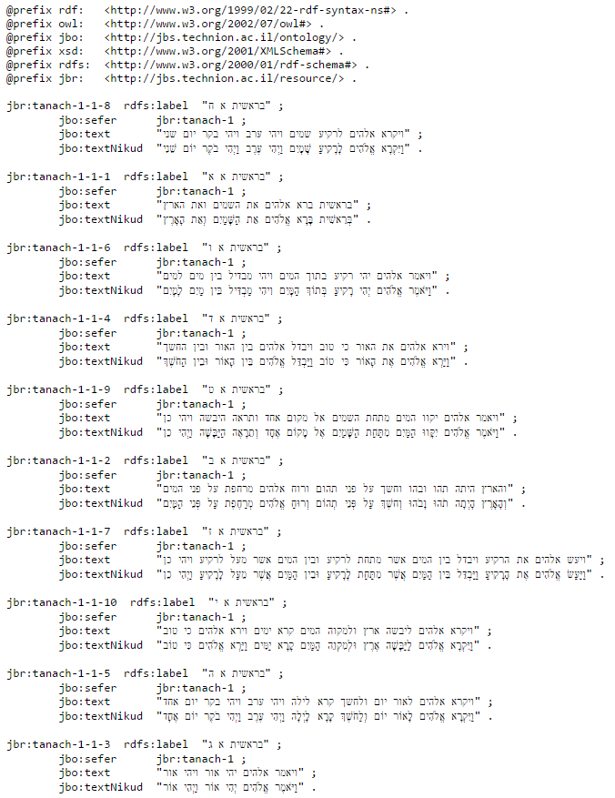
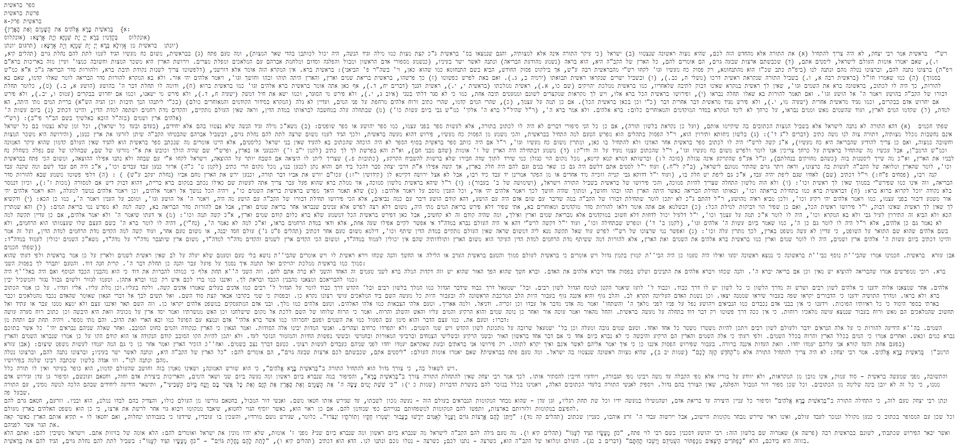
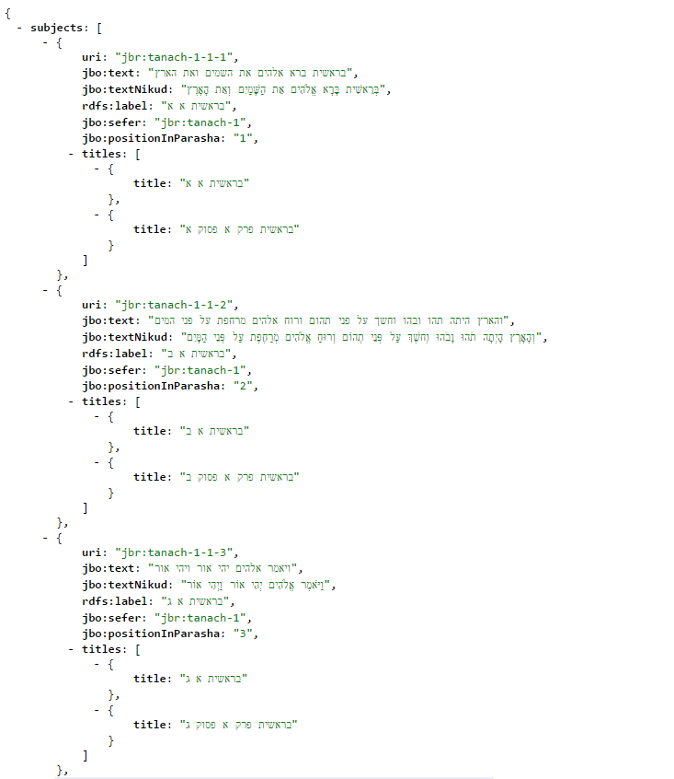
From raw data to RDF

Slide 7
What is ontology?
In order to be able to model entities and abstract data in a domain, we first need to describe a structured common language which gives us the ability to reason over (meta)data.
Creating ontology for the domain allows us to do so.

Slide 8
What are RDF triples?
For example we want to model information of the following RDF diagram:

Slide 9
What are RDF triples?
The corresponding triplets are:
subject | predicate | object
jbr:tanach-1-2-10 | rdfs:label | "בראשית ב י"
jbr:tanach-1-2-10 | jbo:sefer | jbr:tanach-1
jbr:tanach-1-2-10 | jbo:text | "ונהר יצא מעדן להשקות את הגן ומשם יפרד והיה לארבעה ראשים"
jbr:tanach-1-2-10 | jbo:textNikud | "וְנָהָר יֹצֵא מֵעֵדֶן לְהַשְׁקוֹת אֶת הַגָּן וּמִשָּׁם יִפָּרֵד וְהָיָה לְאַרְבָּעָה רָאשִׁים"

Slide 10
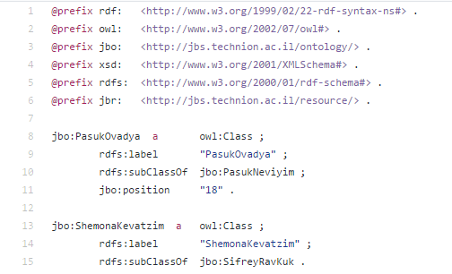
Generating an ontology
Ontology enable us to describe a structured common language which gives us the ability to reason over (meta)data.
Domains
Prefixes
Classes
Predicates
And more…

Slide 11
Generating an ontology
Json23plet allows you to create, modify and update your ontology in a few simple steps:
Create a json file describe the ontology
Run json23plet
Json23plet will create a ttl file (the ontology) and a java class describe the ontology as java object
Useful for referencing to your ontology while writing a generator

Slide 12
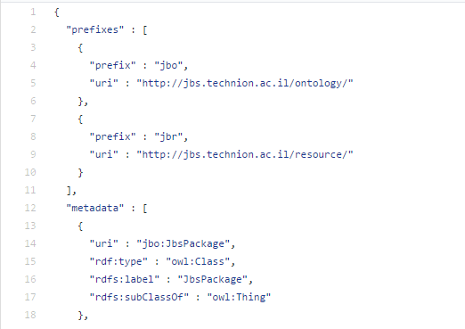
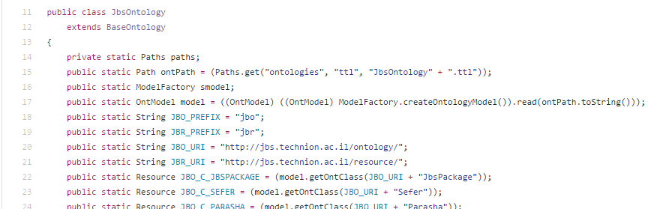
Generating an ontology
TTL
json23plet
JAVA

Slide 13
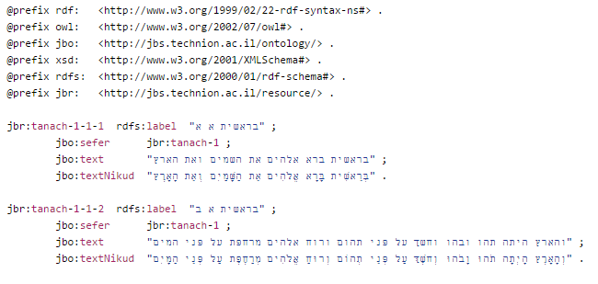
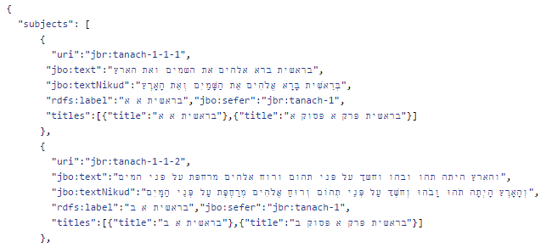
Basic generator
The basic generator allows you to create a RDF model without any programming skills
Takes Json files that are in the basic format
Creats TTL files generically and independently from the semantic of the data
json23plet
TTL

Slide 14
Tool’s dependencies
We used:
Apache Jena library to build the RDF model and export it into Turtle files
Gson library to deal with Json fies
Maven capabilities (json23plet is a Maven project)

Slide 15

Apache Jena
Apache Jena is Java framework for building Semantic web
The framework is composed of different APIs interacting together to process RDF data
It is very complexed and requires much practice in order to understand how to work with
We made the usage of creating RDF triples much simpler by wrap the Apache Jena with our triplet module

Slide 16
RDF type - Regex generator
While developing a Semantic Web domain there might be a lot of changes in Ontology, Predicates, Hierarchy, etc.
We would like to reduce the impact of changes on the existing data and the development process
Assume we decide to change the classes hierarchy, where should we change the flow?
In text2json – requires changes a lot of dedicated and different generators
Creating a generator for each class with json23plet will have the same problem
Therefore, we developed the regex generator framework

Slide 17
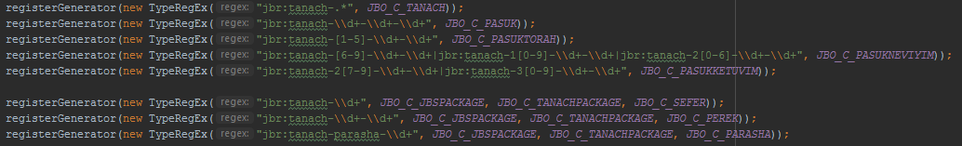
Regex generator
Contains “Rules”
Rule will be activated on a Json object if they match, based on regular expressions matching
Define all your frequently changed generators as rules in regex generator
Now, if something has changed all is needed is to update the appropriate rule and rerun the regex generator
Provides a simple and clean solution to the problem, as seen:

Slide 18

To get inside: https://github.com/TechnionTDK/jbs-json23plet

